Slide 1

SE401 - Software Quality Assurance and Testing
White Box Testing

Slide 2
Thought for the Day
“If you don't like unit testing your product, most likely your customers won't like to test it either.”
– Anonymous

Slide 3
Outline
Case Study - Airbus A320
Program Models and Graphs
White Box Testing
Control Flow Coverage
Beyond Branch and Condition Testing
Path Testing
Cyclomatic Complexity
Cyclomatic Adequacy and Coverage
Java Code Coverage Tools
Summary

Slide 4
Case Study − Airbus A320

Slide 5

Case Study − Airbus A320
Launched in 1984
First civilian fly-by-wire computer system so advanced it can land plane virtually unassisted
No instrument dials – 6 CRTs
Notes:
3/14/2021
5

Slide 6

Case Study − Airbus A320 – Fatal Accidents
Air France Flight 296
Alsace, France, June 26, 1988
The airplane software interpreted the low altitude/downed gear as "We're about to land”
Would not allow the pilot to control the throttle.
3 people died, 133 survived
Indian Airline Flight 605
Bangalore, India, February 14, 1990
92 people died, 56 survived
Air Inter Flight 148
Mont Sainte Odile, January 20, 1992
87 people died, 9 survived
Notes:
Indian Airlines A320 during final approach
Speed drops to dangerously low level causing rapid descent
A320 slams into a golf course just short of runway
Airbus A320 plows into pine forest, approach altitude reads 4700 feet on instruments
Height at impact: about 2500 feet

Slide 7
Case Study − Airbus A320: What Were the Causes?
The fly-by-wire system could ignore pilot actions.
Warning system alerts only seconds before accident.
no time to react
Programmed landing maneuvers with bug in altitude calculation
Altimeter showed the plane was higher than its actual altitude
Flight path angle and vertical speed indicator have the same display format [see note]
confuses pilots
Note:
In vertical speed mode "-3.3" means a descent rate of 3300 feet/min.
In TRK/FPA (track/flight path angle) mode this would have meant a (correct) -3.3 deg descent angle.

Slide 8
Program Models and Graphs

Slide 9
Properties of Models
Compact:
representation of a system
Predictive:
represent some salient characteristics
well enough to distinguish between good and bad
no single model represents all characteristics
Semantically meaningful:
permits diagnosis of the causes of failure
Sufficiently general:
general enough for practical use
Notes:
9

Slide 10
Graph Representations: directed graphs
Directed graph:
N (set of nodes)
E (relation on the set of nodes ) edges
Nodes: {a, b, c}
Edges: {(a,b), (a, c), (c, a)}
a
b
a
c
b
c

Slide 11
Graph Representations: labels and code
We can label nodes with the names or descriptions of the entities they represent.
If nodes a and b represent program regions containing assignment statements, we might draw the two nodes and an edge (a,b) connecting them in this way:
x = y + z;
a = f(x);

Slide 12
Multidimensional Graph Representations
Sometimes we draw a single diagram to represent more than one directed graph, drawing the shared nodes only once
class B extends (is a subclass of) class A
class B has a field that is an object of type C
extends relation
NODES = {A, B, C}
EDGES = {(A,B)}
includes relation
NODES = {A, B, C}
EDGES = {(B,C)}
a
b
c

Slide 13
Example of Control Flow Graph
public static String collapseNewlines(String argStr)
{
char last = argStr.charAt(0);
StringBuffer argBuf = new StringBuffer();
for (int cIdx = 0 ; cIdx < argStr.length(); cIdx++)
{
char ch = argStr.charAt(cIdx);
if (ch != '\n' || last != '\n')
{
argBuf.append(ch);
last = ch;
}
}
return argBuf.toString();
}

Slide 14
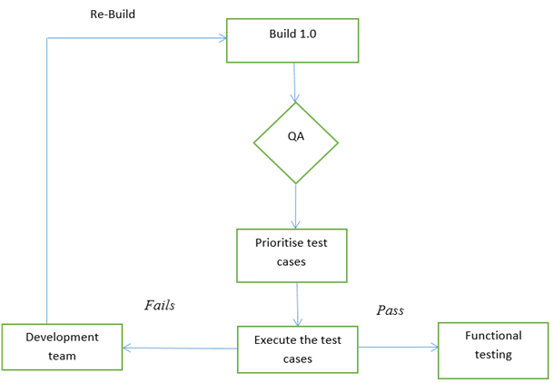
Flowchart
Testers usually use flowcharts in the test plan, test strategy, requirements artifacts or other process documents.
Here are two ways we testers use flow charts:
Flowcharts for control flow and statistical analysis
Flow charts for process illustration

Slide 15
Control Flow Graph (CFG)
Intra-procedural control flow graph
Nodes = regions of source code, basic blocks
maximal program region with a single entry and single exit
Statements are grouped in single block
Single statement can also be broken into multiple nodes
Directed edges = control flow
program execution may proceed from one node to another

Slide 16
White Box Testing a.k.a. Structural Testing

Slide 17
Structural Testing
Judging the thoroughness of a test suite based on the structure of the program
Compare to functional (requirements based, black-box) testing
Structural testing is still testing product functionality against its specification.
Only the measure of thoroughness has changed.
Usually done by the programmers as part of unit testing

Slide 18
Why Structural Testing?
“What is missing in our test suite?”
If part of a program is not executed by any test case in the suite, defects in that part cannot be exposed.
What is a “part”?
Typically, a control flow element or combination:
Statements (or CFG nodes), branches (or CFG edges)
Fragments and combinations: conditions, paths
Complements functional testing:
Another way to recognize cases that are treated differently
Notes:
The fundamental rationale for any systematic (non-random) testing technique is
variation: Testing something different is more valuable than testing the same
thing again. There are many ways to consider “same” and “different”, and we
find value in any sense of “different” that might reveal faults that were not
revealed by other test cases. Functional testing uses the program specification
to say what is “different” (systematically covering cases that can be identified
in the specification). Structural testing

Slide 19
Testing with variation...
The fundamental rationale for any systematic (non-random) testing technique is variation: Testing something different is more valuable than testing the same thing again.
There are many ways to consider same and different, and we find value in any sense of different that might reveal faults that were not revealed by other test cases.
Functional testing uses the program specification to say what is different (systematically covering cases that can be identified in the specification).

Slide 20
No Guarantee of Finding All Defects
Executing all control flow elements does not guarantee finding all defects
Execution of a faulty statement may not always result in a failure
The state may not be corrupted when the statement is executed with some data values
Corrupt state may not propagate through execution to eventually lead to failure
What is the value of structural coverage?
Increases confidence in the thoroughness of testing
Removes some obvious inadequacies
Notes:
Structural testing provides a basic check: Did we completely leave miss
something that should have been tested? It doesn't guarantee that the
test cases we chose were good.
Despite the limitation, it's valuable because a good test designer does not
just blindly satisfy a structural coverage criterion. Structural criteria serve
as reminders to think carefully about what has been missed, and choose
good test cases for the underlying difference in treatment by the program.

Slide 21
Structural testing brings value...
Structural testing provides a basic check: Did we completely leave/miss something that should have been tested? It doesn’t guarantee that the test cases we chose were good.
Despite the limitation, it's valuable because a good test designer does not just blindly satisfy a structural coverage criterion.
Structural criteria serve as reminders to think carefully about what has been missed, and choose good test cases for the underlying difference in treatment by the program.

Slide 22
Structural Testing Complements Functional Testing
Include cases that may not be identified from specifications alone
Implementation of a single item of the specification by multiple parts of the program
Example: hash table collision (invisible in interface spec)
Satisfying control flow adequacy criteria could still fail to reveal defects
Missing path

Slide 23
Structural Testing in Practice
Typical process
Create functional test suite first
Measure structural coverage to identify what is missing
Add additional test cases
Interpret unexecuted elements
Natural differences between specification and implementation
Flaws of the software or its development process
Attractive because it can be automated
Coverage measurements are convenient progress indicators
Sometimes used as a criterion of completion
Caution: does not ensure effective test suites

Slide 24
Control Flow Coverage

Slide 25
Test Adequacy Criterion
Adequacy criterion of a test suite
Whether a test suite satisfies some property deemed important to thoroughly test a program
e.g.,
Cover all statements
Cover all branches

Slide 26
Control Flow Based Adequacy Criteria and Coverage
Statement coverage
Cover every statement at least once
Branch coverage, a.k.a. decision coverage
Cover every branch at least once
(Basic) Condition coverage
Cover each outcome of every condition
Branch-Condition coverage
Cover all conditions and all branches
Modified condition decision coverage (MC/DC)
Compound condition coverage
Cover all possible combinations of every condition

Slide 27
Condition Coverage
A decision can be composed of a simple condition such as
x<0
or of a more complex condition, such as
((x<0 AND y<0 ) OR (p≥q))
AND, OR, XOR are the logical operators that connect two or more simple conditions to form a compound condition.
A simple condition is considered covered if it evaluates to true and false in one or more executions of the program in which it occurs.
A compound condition is considered covered if each simple condition it contains is also covered.

Slide 28

Decision and Condition Coverage
Decision coverage is concerned with the coverage of decisions regardless of whether or not a decision corresponds to a simple or a compound condition. Thus, in the statement
there is only one decision that leads control to line 2 if the compound condition inside the if evaluates to true.
However, a compound condition might evaluate to true or false in one of several ways.

Slide 29
Decision and condition coverage (contd)
The condition at line 1 evaluates to false when x≥0 regardless of the value of y.
Another condition, such as x<0 OR y<0, evaluates to true regardless of the value of y, when x<0.
With this evaluation characteristic in view, compilers often generate code that uses short circuit evaluation of compound conditions.

Slide 30
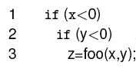
Decision and Condition coverage (contd)
Here is a possible translation:
We now see two decisions, one corresponding to each simple condition in the if statement.

Slide 31
A Simple Example of Coverage
if ( a < b and c == 5) {
y++;
}
x = 5;
Test cases:
(a) a < b, c == 5
(b) a < b, c != 5
(c) a >= b, c == 5
(d) a >= b, c != 5
Statement coverage:
Test case (a)
Branch coverage:
Test cases (a) and (b)
(Basic) Condition coverage:
Test case (b) and (c)
Problem: and (&&) short circuits! And second half of (c) not executed.
Branch-Condition coverage:
Test case (a) (b) and (c)
Compound condition coverage:
Test case (a) (b) (c) and (d)
* and is interpreted as logical-and

Slide 32
Statement Testing
Adequacy criterion:
each statement (or node in the CFG) must be executed at least once
Coverage:
# executed statements
# statements
Rationale:
A defect in a statement can only be revealed by executing the faulty statement
Notes:
12.2 STATEMENT TESTING

Slide 33
Statements or Blocks?
Nodes in a CFG often represent basic blocks of multiple statements
basic block coverage or node coverage
difference in granularity, not in concept
No essential difference
100% node coverage ⇔ 100% statement coverage
but levels will differ below 100%
A test case that improves one will improve the other
though not by the same amount, in general

Slide 34
Example: cgi_decode
Function cgi_decode translates a cgi-encoded string to a plain ASCII string, reversing the encoding applied by the common gateway interface (CGI) of most web servers
CGI translates spaces to +, and translates most other non-alphanumeric characters to hexadecimal escape sequences
cgi_decode maps + to spaces, %xy (where x and y are hexadecimal digits) to the corresponding ASCII character, and other alphanumeric characters to themselves

Slide 35
Example: cgi_decode
int cgi decode(char *encoded, char *decoded) {
char *eptr = encoded;
char *dptr = decoded;
int ok=0;
while (*eptr) {
char c;
c = *eptr;
/* Case 1: ’+’ maps to blank */
if (c == ’+’) {
*dptr = ’ ’;
} else if (c == ’%’) {
/* Case 2: ’%xx’ is hex for character xx */
int digit high = Hex Values[*(++eptr)];
int digit low = Hex Values[*(++eptr)];
/* Hex Values maps illegal digits to -1 */
if ( digit high == -1 || digit low == -1 ) {
/* *dptr=’?’; */
ok=1; /* Bad return code */
} else {
*dptr = 16* digit high + digit low;
}

Slide 36
Example: cgi_decode
/* Case 3: All other characters map to themselves */
} else {
*dptr = *eptr;
}
++dptr;
++eptr;
}
*dptr = ’\0’; /* Null terminator for string */
return ok;
}

Slide 37
Example: cgi_decode
T₀ = {
“”,
“test”,
“test+case%1Dadequacy”
}
17/18 = 94% Stmt Cov.
T₁ = {
“adequate+test%0Dexecution%7U”
}
18/18 = 100% Stmt Cov.
T₂ = {
“%3D”,
“%A”,
“a+b”,
“test”
}
18/18 = 100% Stmt Cov.
Notes:
T0, T1, T2 are test suites (sets of test cases)
In T0 (3 test cases):
“” covers nodes A, B, M
“test” covers nodes A, B, C, D, F, L, …, B, M
“test+case%1Dadequacy” covers nodes
A, B, C, D, F, L, ... B, C, E, L, ..., B, C, D, G, H, L, ... B, M
In T1 (one test case):
“adequate+test%0Dexecution%7U” covers nodes
A, B, C, D, F, L, ... B, C, E, L, ..., B, C, D, G, H, L, ... B, C, D, G, I, L, ... B, M
In T2 (4 test cases):
“%3D” covers A, B, C, D, G, H, L, B, M
“%A” covers A, B, C, D, G, I, L, B, M
“a+b” covers A, B, C, D, F, L, B, C, E, L, ...,M
“test” covers A, B, C, D, F, L, ..., M

Slide 38
Coverage is Not Size
Coverage does not depend on the number of test cases
Compare T₀ , T₁ : T₁ >_{coverage} T₀ T₁ <_{cardinality} T₀
Compare T₁ , T₂ : T₂ =_{coverage} T₁ T₂ >_{cardinality} T₁
Minimizing test suite size is seldom the goal
Small test cases make failure diagnosis easier
A failing test case in T₂ gives more information than a failing test case in T₁

Slide 39
“All Statements” Can Miss Some Cases
Complete statement coverage may not imply executing all branches.
Example:
Suppose block F were missing
Statement adequacy would not require false branch from D to L
T₃ =
{
“”, “+%0D+%4J”
}
100% Stmt Cov.
No false branch from D
Notes:
12.3 BRANCH TESTING

Slide 40
Branch Testing
Adequacy criterion:
each branch (edge in the CFG) of every selection statement (if, switch) must be executed at least once
Coverage:
# executed branches
# branches
T₃ = { “”, “+%0D+%4J” }
100% Stmt Cov. 88% Branch Cov. (7/8 branches)
T₂ = { “%3D”, “%A”, “a+b”, “test” }
100% Stmt Cov. 100% Branch Cov. (8/8 branches)

Slide 41
Statements vs. Branches
Traversing all edges of a graph causes all nodes to be visited
Satisfying branch adequacy implying satisfying the statement adequacy
The converse is not true (see T₃)
A statement-adequate (or node-adequate) test suite may not be branch-adequate (edge-adequate)
Notes:
The example of two slides ago illustrates this point

Slide 42
“All Branches” Can Still Miss Conditions
Sample fault: missing operator (negation)
if (digit_high == 1 || digit_low == -1)
Branch adequacy criterion can be satisfied by varying only digit_low
The faulty sub-expression might never determine the result
We might never really test the faulty condition, even though we tested both outcomes of the branch
Notes:
Recall we're trying to exercise each of the significant cases in the code.
A single branch statement (“if”, “while”, etc.) may actually combine different cases in a complex condition, and exercising both outcomes of the branch may not exercise each part of the complex condition.

Slide 43
Condition Testing
Branch coverage exposes faults in how a computation has been decomposed into cases
check the programmer's case analysis
but only roughly: groups cases with the same outcome
Condition coverage considers case analysis in more detail
individual conditions (predicates) in a compound condition
e.g., both parts of digit_high == 1 || digit_low == -1
Notes:
12.4 CONDITION TESTING

Slide 44
(Basic) Condition Testing
Adequacy criterion:
Both outcomes (true and false) of each basic condition or predicate, must be tested at least once
Basic condition or predicate: a Boolean expression that does not contain other Boolean expression
Coverage:
# truth values taken by all basic conditions
2 * # basic conditions
[See note]
Notes:
the total number of truth values that the basic conditions can take is twice the number of basic conditions, since each basic condition can assume value true or false

Slide 45
Basic Conditions vs. Branches
Basic condition adequacy criterion can be satisfied without satisfying branch coverage
T4 = { “first+test%9Ktest%K9” }
satisfies basic condition adequacy
does not satisfy branch condition adequacy
if (digit_high == -1 || digit_low == -1)
%9K false true
%K9 true false
Branch and basic condition are not comparable
(neither implies the other)
Notes:
Unlike branches and statements (where covering all branches was enough to also cover all statements),
covering all basic conditions does not replace covering all branches.

Slide 46
Branch-Condition Testing
Branch and condition adequacy
Cover all conditions and all branches
Both outcomes (true and false) of each basic condition must be tested at least once.
All branches of every selection statement must be executed at least once .
Notice that due to the left-to-right evaluation order and short-circuit evaluation of logical OR expressions in the C language, the value true for the first condition does not need to be combined with both values false and true for the second condition.
Notes:
Notice that due to the left-to-right evaluation order and short-circuit evaluation of logical OR expressions in the C language, the value true for the first condition does not need to be combined with both values false and true for the second condition.

Slide 47
Beyond Branch and Condition Testing

Slide 48
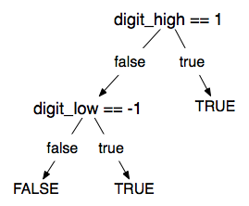
Compound Condition Testing
Compound (multiple) condition adequacy:
Cover all possible combinations of compound conditions and cover all branches of a selection statement
For a compound condition with
n basic conditions,
2^{n} test cases may be needed.
 | C1 | C2 | C
T1 | T | T | T
T2 | T | F | F
T3 | F | T | F
T4 | F | F | F
C = C1 and C2
Notes:
Notice that due to the left-to-right evaluation order and short-circuit evaluation of logical OR expressions in the C language, the value true for the first condition does not need to be combined with both values false and true for the second condition.

Slide 49
Compound Conditions: Exponential Complexity
(((a || b) && c) || d) && e
Test Case a b c d e
(1) T — T — T
(2) F T T — T
(3) T — F T T
(4) F T F T T
(5) F F — T T
(6) T — T — F
(7) F T T — F
(8) T — F T F
(9) F T F T F
(10) F F — T F
(11) T — F F —
(12) F T F F —
(13) F F — F —
short-circuit evaluation often reduces this to a more manageable number, but not always
Notes:
Why do we care? Because even one very complex condition in a program could require
an impractical number of test cases. For example, a condition with 16 basic conditions
could require more than 32,000 test cases (although this is unlikely in practice, because
very large conditions are more typically just one big disjunction or one big conjunction,
which are effectively reduced to a linear number of cases by short-circuit evaluation).

Slide 50
Modified Condition/Decision Coverage (MC/DC)
Motivation:
Effectively test important combinations of conditions, without exponential blowup in test suite size
“Important” combinations means:
each basic condition shown to independently affect the outcome of each decision
Requires: For each basic condition C, two test cases,
C evaluates to true for one and false for the other
Values of all other evaluated conditions remain the same
The compound condition as a whole evaluates to true for one and false for the other
Notes:
If we don't want to test all possible combinations, then we have to say which combinations are important.
One good choice is to choose combinations that show how each basic condition can affect the outcome,
i.e., how changing that one condition can change the value of the whole compound condition. That's
what the “modified condition/decision” criterion requires.

Slide 51
Construct Test Cases for MC/DC
MC/DC with two basic conditions
C = C1 && C2
C = C1 || C2
 | C1 | C2 | C
T1 | T | T | T
T2 | T | F | F
T3 | F | T | F
 | C1 | C2 | C
T1 | T | F | T
T2 | F | T | T
T3 | F | F | F

Slide 52
Construct Test Cases for MC/DC
MC/DC with three basic conditions
C = (C1 && C2)&& C3
Copy rows T1, T2, T3 in the (C1 && C2) table to the table below and
Fill in true for column C3
Operator || can be handled similarly (symmetric)
 | C1 | C2 | C3 | C
T1 | T | T | T | T
T2 | T | F | T | F
T3 | F | T | T | F
T4

Slide 53
Construct Test Cases for MC/DC
MC/DC with three basic conditions
C = (C1 && C2) && C3
Add a new row for T4
Column C3: false
Column C1 and C2: copy the values from one of T1, T2, or T3 with true outcome
 | C1 | C2 | C3 | C
T1 | T | T | T | T
T2 | T | F | T | F
T3 | F | T | T | F
T4 | T | T | F | F

Slide 54
MC/DC: Linear Complexity
Only n+1 test cases needed for n basic conditions
Adopted by many industry quality standards
(((a || b) && c) || d) && e
Test Case a b c d e Outcome
(1) true -- true -- true true
(2) false true true -- true true
(3) true -- false true true true
(6) true -- true -- false false
(11) true -- false false -- false
(13) false false -- false -- false
Values in red independently affect the output of the decision
Notes:
This is the same table as two slides ago, omitting redundant cases.
Cases 4,5, 7-10, and 12 have been omitted.
In each column we find two rows in which that column is underlined. For example, the “a” column is underlined in rows (1) and (13). All the evaluated conditions in those two rows are the same except for that column. For example, to show that changing “a” from true to false in case (1) would change the outcome, we
* Fill in the “don't care” columns in row 1 with values from row 13 (because this doesn't change anything
* Then see that the rows are completely identical except in column “a” and the outcome so clearly changing the value of “a” changed the outcome.
The number of test cases needed is hardly more than for basic condition coverage, but MC/DC is much better than basic condition coverage at exposing faults in conditional expressions, so it is clearly superior (and therefore very widely used, and specified in some standards).

Slide 55
Analysis of MC/DC
MC/DC is
basic condition coverage (C)
decision (branch) coverage (DC)
plus one additional condition (M): every condition must independently affect the decision's outcome
Subsumed by compound conditions
Subsumes all other criteria discussed so far
stronger than statement and branch coverage
A good balance of thoroughness and test size
therefore widely used
Notes:
(This mainly restates comments on the previous slide, and can be used
or skipped depending on lecture style)

Slide 56
Leave (Almost) No Code Untested
In general
90% coverage is achievable
95% coverage require significant effort
100% not always attainable
Challenges in coverage
Platform specific code
Defensive programming
Exception handling
Non-public method, never invoked

Slide 57
Summary
Rationale for structural testing
Basic terms: adequacy, coverage
Characteristics of common structural criteria
Statement, branch, condition, compound condition, MC/DC
Practical uses and limitations of structural testing

Slide 58
Thought for the Day
“Just because you've counted all the trees doesn't mean you've seen the forest.” – Anonymous

Slide 59
White Box Testing
Sometimes called “glass-box” testing.
Uses the control structure from the component-level design to derive test cases.
Objective:
To guarantee that all independent paths within a module have been exercised at least once.
Exercise all logical decisions on their true and false sides.
Execute all loops at their boundaries and within their operational bounds.
Exercise internal data structures to ensure their validity.

Slide 60
Path Testing

Slide 61
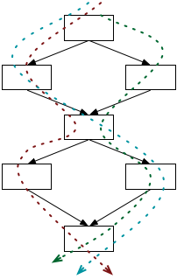
Paths Testing
Beyond individual branches.
Should we explore sequences of branches (paths) in the control flow?
Many more paths than branches
A pragmatic compromise will be needed

Slide 62
Path Coverage
Path coverage means that all possible execution paths in the program must be executed.
This is a very strong coverage criterion, but impractical.
Programs with loops have an infinite number of execution paths, and thus would need an infinite number of test cases
The fact that there is complete branch coverage does not mean that all errors will be found. Branch testing does not necessarily check all combinations of control transfers.

Slide 63
Path Adequacy
Decision and condition adequacy
Test individual program decisions
Paths testing
Test combinations of decisions along paths
Adequacy criterion:
Each path must be executed at least once
Coverage:
# executed paths
# total paths
Notes:
12.5 PATH TESTING
Path coverage simply requires each path to be executed at least once, thus helping in revealing failures that occur when loops are executed several times. Unfortunately, “pure” path coverage is impractical even for simple programs (the program on the slide has infinite many paths). An easy way to reduce the number of paths is to limit the number of times of executions of each loop.

Slide 64
Practical Path Coverage Criteria
The number of paths in a program with loops is unbounded
the simple criterion is impossible to satisfy
For a feasible criterion:
Partition infinite set of paths into a finite number of classes
Useful criteria can be obtained by limiting
the number of traversals of loops
the length of the paths to be traversed
the dependencies among selected paths
Notes:
PATH TESTING
Path coverage simply requires each path to be executed at least once, thus helping in revealing failures that occur when loops are executed several times. Unfortunately, “pure” path coverage is impractical even for simple programs with loops. To ensure a finite number of paths, we must at least limit the number of times of executions of each loop (e.g., lump “5 iterations” and “105 iterations” in the same class “more than 1 iteration”, requiring only one representative execution from that class).

Slide 65
Boundary Interior Path Testing
Group together paths that differ only in the sub-path they follow when repeating the body of a loop
Follow each path in the control flow graph up to the first repeated node
The set of paths from the root of the tree to each leaf is the required set of sub-paths for boundary/interior coverage

Slide 66
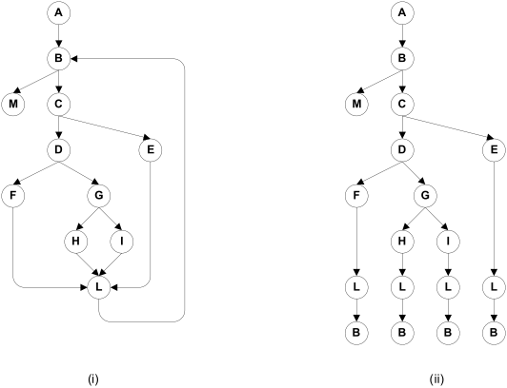
Boundary Interior Adequacy for cgi-decode
Notes:
The graph at the right shows the paths that must be covered in the control flow graph at the left, using the “boundary interior”
adequacy criiterion.

Slide 67
Limitations of Boundary Interior Adequacy
The number of paths can still grow exponentially
if (a) {
S1;
}
if (b) {
S2;
}
if (c) {
S3;
}
...
if (x) {
Sn;
}
The sub-paths through this control flow can include or exclude each of the statements Si
Total N branches result in 2^{N} paths that must be traversed
Choosing input data to force execution of one particular path may be very difficult
even impossible if the conditions are not independent

Slide 68
Loop Boundary Adequacy
A test suite satisfies the loop boundary adequacy criterion iff for every loop:
At least one test case: the loop body is iterated zero times
At least one test case: the loop body is iterated once
At least one test case: the loop body is iterated more than once

Slide 69
What is LCSAJ Testing ?
LCSAJ stands for Linear Code Sequence and Jump, a white box testing technique to identify the code coverage, which begins at the start of the program or branch and ends at the end of the program or the branch.
LCSAJ consists of testing and is equivalent to statement coverage.
LCSAJ Characteristics:
100% LCSAJ means 100% Statement Coverage
100% LCSAJ means 100% Branch Coverage
100% procedure or Function call Coverage
100% Multiple condition Coverage

Slide 70
Linear Code Sequence and Jump (LCSAJ)
Execution of sequential programs that contain at least one condition, proceeds in pairs where the first element of the pair is a sequence of statements, executed one after the other, and terminated by a jump to the next such pair.
A Linear Code Sequence and Jump is a program unit comprised of a textual code sequence that terminates in a jump to the beginning of another code sequence and jump.
An LCSAJ is represented as a triple (X, Y, Z) where X and Y are, respectively, locations of the first and the last statements and Z is the location to which the statement at Y jumps.

Slide 71
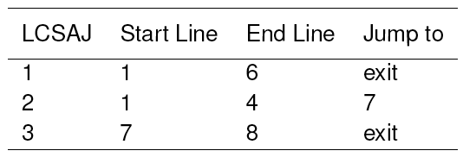
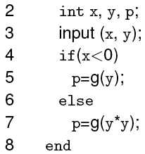
Linear Code Sequence and Jump (LCSAJ)
Consider this program.
The last statement in an LCSAJ (X, Y, Z) is a jump and Z may be program exit. When control arrives at statement X, follows through to statement Y, and then jumps to statement Z, we say that the LCSAJ (X, Y, Z) is traversed or covered or exercised.

Slide 72
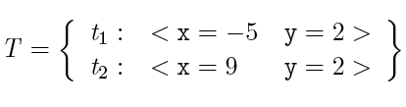
LCSAJ coverage: Example 1
t2 covers (1,4,7) and (7, 8, exit).
t1 covers (1, 6, exit).
T covers all three LCSAJs.

Slide 73
Basis Path Testing
First proposed by Tom McCabe in 1976. Later expanded it into Cyclomatic Complexity.
Enables the test case designer to derive a logical complexity measure of the procedural design.
Uses this measure as the basis for defining an upper bound on the number of execution paths needed to guarantee that every statement in the program is executed at least once.
Uses a notation known as a flow graph.
Each structured notation has a corresponding flow graph symbol.

Slide 74
Flow Graph Notation
Sequence
if
Case
until
while
Where each circle represents one or more nonbranching set of source code statements.

Slide 75
Flow chart and corresponding flow graph
1
1
2,3
R₁
2
6
R₂
3
7
R₄
8
4,5
9
6
4
7
8
5
R₃
10
9
10
11
R = Regions
11

Slide 76
Compound logic
A compound condition occurs when one or more Boolean operators (logical OR, AND, NAND, NOR) is present in a conditional statement.
Example:
if a OR b then do X else do Y endif
a
a
b
x
b
y
x
y
x

Slide 77
Independent Program Paths
Any path through the program that introduces at least one new set of processing statements or a new condition.
In terms of a flow graph, an independent path must move along at least one edge that has not previously been traversed.

Slide 78
Basis Paths Example
Basis paths: Path 1: 1-11 Path 2: 1-2-3-4-5-10-1-11 Path 3: 1-2-3-6-8-9-10-1-11 Path 4: 1-2-3-6-7-9-10-1-11
The path below is NOT a basis path 1-2-3-4-5-10-1-2-3-6-8-9-10-1-11 because it does not traverse any new edges.
1
2
3
6
4
7
8
5
9
10
11

Slide 79
Choose a Set of Basis Paths
Traverse the CFG to identify basis paths
Each path contains at least one edge that is not in other paths.
No iteration of sub-paths
There is more than one set of basis paths for a given CFG.

Slide 80
Basis Paths
These paths constitute a basis set for the flow graph.
Design tests to execute these paths.
Guarantees:
Every statement has been executed at least once.
Every condition has been executed on both its true and false sides.
There is more than ONE correct set of basis paths for a given problem.
How many paths should we look for?
Calculate Cyclomatic complexity V(G)
V(G) = E-N+2
V(G) = P + 1 (Where P = number of predicate nodes)
V(G) = R (Where R = number of regions)

Slide 81
Cyclomatic Complexity (CC)
Evaluates the complexity of an algorithm in a method. It measures the number of linearly independent paths through a program's source code
Three equivalent definitions
V(G) = E-N+2
Or given a flow graph: = edges – nodes + 2
V(G) = P + 1 (Where P = number of predicate nodes)
Defined to be one larger than the number of decision points (if/case-statements, while-statements, etc.) in a module (function, procedure, chart node, etc.).
Note that in an if or while statement, a complex boolean counts each part, (e.g. if( a<b and c>0) counts as two decision points.
V(G) = R (Where R = number of regions)
Notes:
http://satc.gsfc.nasa.gov/support/STC_APR98/apply_oo/apply_oo.html

Slide 82
Cyclomatic Complexity (CC)
Evaluates the complexity of an algorithm in a method.
Calculate the cyclomatic complexity.
A method with a low cyclomatic complexity is generally better. This may imply decreased testing and increased understandability or that decisions are deferred through message passing, not that the method is not complex
Notes:
http://satc.gsfc.nasa.gov/support/STC_APR98/apply_oo/apply_oo.html

Slide 83
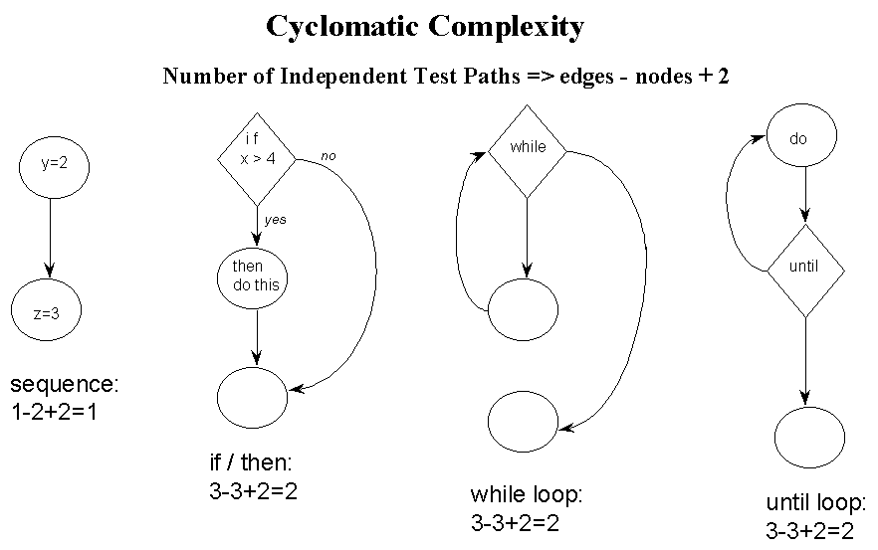
Cyclomatic Complexity (CC)
CC = edges – nodes + 2
Notes:
http://satc.gsfc.nasa.gov/support/STC_APR98/apply_oo/apply_oo.html

Slide 84
Cyclomatic Testing
A compromise between path testing and branch-condition testing
Cyclomatic testing, a.k.a., basis path testing
Test all of the independent paths that could be used to construct any arbitrary path through the computer program
Steps:
1. Calculate Cyclomatic complexity 2. Choose a set of basis paths 3. Design test cases to exercise each basis path

Slide 85
Cyclomatic Complexity (McCabe)
A set of basis paths in a CFG
Each path contains at least one edge that is not in other paths
No iteration of sub-paths
The number of basis paths in a CFG is known as the Cyclomatic Complexity of the CFG
Calculate Cyclomatic complexity of CFG G
e = #edges in G
n = #nodes in G
The cyclomatic complexity of G
V(G) = e - n + 2

Slide 86
Cyclomatic Complexity (McCabe)
If a CFG has a single entry and single exit point,
the calculation of the cyclomatic complexity can be simplified
V(G) = #predicates + 1
Rules for counting predicates in CFG
Condition in a if-statement: count each predicate
Condition in a loop statement count as 1, even if it's a compound condition
Switch statement: n-way choice count as (n -1)

Slide 87
Cyclomatic Complexity Examples
statement₁
statement₂
…
statement_{n}
if (x > 5) {
statement₁
}
if (x > 5) {
statement₁
} else {
statement₂
}

Slide 88
Cyclomatic Complexity Examples
statement₁
statement₂
…
statement_{n}
if (x > 5) {
statement₁
}
if (x > 5) {
statement₁
} else {
statement₂
}
V(G) = 2
V(G) = 1
V(G) = 2

Slide 89
Cyclomatic Complexity Examples
switch (exp) {
case v₁: statement₁; break;
case v₂: statement₂; break;
…
case v_{n}: statement_{n}; break;
default: statement_{n+1};
}
if (x > 5 || x <= 10) {
statement₁
}
if (x >= 0 && x <= 100) {
statement₁
} else if (x <= 30) {
statement₁
} else {
statement₂
}

Slide 90
Cyclomatic Complexity Examples
switch (exp) {
case v₁: statement₁; break;
case v₂: statement₂; break;
…
case v_{n}: statement_{n}; break;
default: statement_{n+1};
}
if (x > 5 || x <= 10) {
statement₁
}
if (x >= 0 && x <= 100) {
statement₁
} else if (x <= 30) {
statement₁
} else {
statement₂
}
V(G) = 3
V(G) = n + 1
V(G) = 4

Slide 91
Cyclomatic Complexity Examples
while (i < 100) {
statement₁;
}
while (i < 100 && a != null) {
statement₁;
}
for (i = 0; i < 10; i++) {
statement₁
}
for (i = 0; i <= 10 || j == 0;
i++) {
statement₁;
if (i > 5 || i <= 10) {
statement₂
}
}

Slide 92
Cyclomatic Complexity Examples
while (i < 100) {
statement₁;
}
while (i < 100 && a != null) {
statement₁;
}
for (i = 0; i < 10; i++) {
statement₁
}
for (i = 0; i <= 10 || j == 0;
i++) {
statement₁;
if (i > 5 || i <= 10) {
statement₂
}
}
V(G) = 2
V(G) = 2
V(G) = 4
V(G) = 2

Slide 93
Cyclomatic Adequacy and Coverage
Cyclomatic adequacy criterion
Each basis path must be executed at least once
Guarantees:
Every statement has been executed at least once.
Every condition has been executed on both its true and false sides.
Recommended by NIST as a baseline technique
Cyclomatic coverage
the number of basis paths that have been executed, relative to cyclomatic complexity
# executed basis paths
cyclomatic complexity
Notes:
There is nothing deep to be grasped here about linearly independent paths, but cyclomatic complexity is used in industry for test planning (estimating testing effort) and sometimes as an adequacy measure. Its attractions are that cyclomatic complexity serves as a simple, rough estimate of the complexity of code, and it requires more testing effort for code with complex control flow than for code with simple control flow. “Linear independence” requires some differences between test cases that can be counted toward thorough testing, even if it is not closely related to the programmer's case analysis.

Slide 94
An Example:
Float Function CalculateFees ( String mgroup, Integer mAge, Float mBaseFees, Integer mFamilyCount, Integer mMinFee)
/* How many months left in the year */
1 MonthsLeft = 12 – GetMonth(SystemDate())
/* Calculate base rate for the group */
2 if mgroup == 1 then
3 mRate = mBaseFees
4 else
5 if mgroup == 2 then
6 mRate = mBaseFees * 0.80
7 else
8 mRate = mBaseFees * 0.65
9 endif
10 endif
11 mBaseFees = mRate * MonthsLeft
12 while mFamilyCount > 1 and mBaseFees > mMinFee
13 if mAge >= 21
14 mBaseFees = mBaseFees – 10
15 else
16 mBaseFees = mBaseFees – 5
17 endif
18 mFamilyCount = mFamilyCount – 1
19 endwhile
20 return mBaseFees

Slide 95
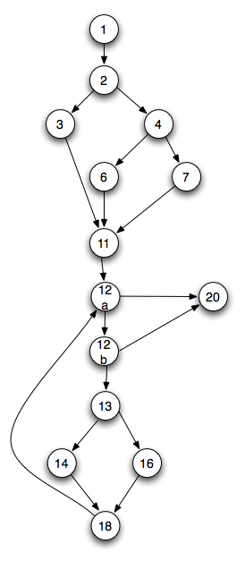
Steps for deriving test cases
Use the design or code as a foundation and draw corresponding flow graph.
Determine the Cyclomatic complexity of the resultant flow graph.
V(G) = 5 predicate nodes + 1 = 6.
[Line 12 has two predicates]

Slide 96
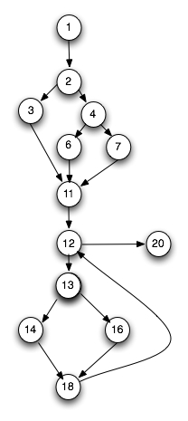
Steps for deriving test cases
Determine a basis set of linearly independent paths.
1-2-3-11-12-20 1-2-4-6-11-12-20 1-2-4-7-11-12-20 1-2-3-11-12-13-14-18-12-20 1-2-4-6-11-12-13-14-18-12-20 1-2-4-7-11-12-13-14-18-12-20 1-2-3-11-12-13-16-18-12-20 1-2-4-6-11-12-13-16-18-12-20 1-2-4-7-11-12-13-16-18-12-20
Prepare test cases that will force execution of each path in the basis set.

Slide 97
Infeasible Paths
Some paths are infeasible…
begin
1. readln (a);
2. if a > 15
then
3. b:=b+1;
else
c:=c+1;
if a < 10
then
6. d:=d+1;
7. end
V(G) = 3: There are three basis paths:
Path 1: 1,2,3,5,7 Path 2: 1,2,4,5,7 Path 3: 1,2,3,5,6,7
Which of these paths is non-executable and why?

Slide 98
Comparing Criteria
Can we distinguish stronger from weaker adequacy criteria?
Empirical approach:
Study the effectiveness of different approaches to testing in industrial practice
What we really care about, but ...
Depends on the setting; may not generalize from one organization or project to another
Analytical approach:
Describe conditions under which one adequacy criterion is provably stronger than another
Stronger = gives stronger guarantees
One piece of the overall “effectiveness” question

Slide 99
The Subsumes Relationship
The subsumption relationship means that satisfying one test coverage criterion may implicitly force another test coverage criterion to be satisfied as well
E.g.: Branch coverage forces statement coverage to be attained as well (This is strict subsumption)
“Subsumes” does not necessarily mean “better”

Slide 100
The Subsumes Relation
Test adequacy criterion A subsumes test adequacy criterion B iff, for every program P, every test suite satisfying A with respect to P also satisfies B with respect to P.
Example:
Exercising all program branches (branch coverage) subsumes exercising all program statements
A common analytical comparison of closely related criteria
Useful for working from easier to harder levels of coverage, but not a direct indication of quality

Slide 101
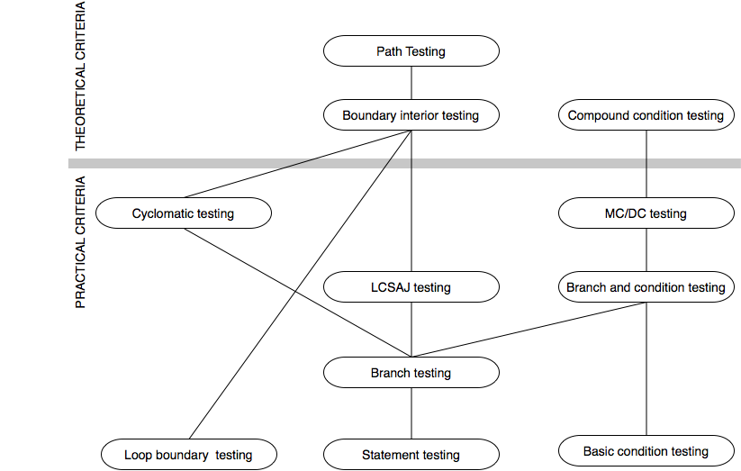
The Subsumes Relation among Structural Testing Criteria
Notes:
NOTE: This diagram is revised (corrected) from the version that appears in the book --- the position of “loop boundary testing” has been changed to properly reflect the definition
given in the book.
The criteria above the bar are of theoretical interest, but can require either an exponential number of test cases relative to program size (compound condition testing, boundary interior testing) or a
potentially infinite number of test cases (path testing). The criteria below the bar are “practical” in the sense that the number of test cases they require, even in the worst case, is only linear in
program size, and all of them have been used in industrial practice.
Since MC/DC and loop boundary testing are mutually incomparable, and since each is closely tied to program logic (reflecting the case analysis that a programmer must consider to write and justify the code), they are an attractive combination.

Slide 102
Satisfying Structural Criteria
Sometimes criteria may not be satisfiable
The criterion requires execution of
statements that cannot be executed as a result of
defensive programming
code reuse (reusing code that is more general than strictly required for the application)
conditions that cannot be satisfied as a result of
interdependent conditions
paths that cannot be executed as a result of
interdependent decisions
Notes:
12.8 THE INFEASIBILITY PROBLEM

Slide 103
Satisfying Structural Criteria
Large amounts of fossil code may indicate serious maintainability problems
But some unreachable code is common even in well-designed, well-maintained systems
Solutions:
make allowances by setting a coverage goal less than 100%
require justification of elements left uncovered
RTCA-DO-178B and EUROCAE ED-12B for modified MC/DC
Notes:
12.8 THE INFEASIBILITY PROBLEM

Slide 104
Java Code Coverage Tools
Emma
Clover
Cobertura
JaCoCo
JCov
Serenity
See: https://en.wikipedia.org/wiki/Java_Code_Coverage_Tools

Slide 105
Summary
Basis path testing should be applied to critical modules
Adequacy criteria and coverage
statement
branch
condition, branch-condition, compound condition
MC/DC
paths
boundary/interior
loop boundary
LCSAJ
Cyclomatic, basis path
Full coverage is usually unattainable

